Slide 1
Guide for
APPATTACK
by Vansh Khanna

Slide 2
Guide for
AppAttack
Question
What does it cover?
This guide aims to highlight critical aspects that new students working on capstone projects may overlook. While it is not comprehensive, it provides a brief overview of some important areas. If additional assistance is required, please do not hesitate to contact us.
By Vansh Khanna
(Co-Lead App Attack)
Page 02

Slide 3
Guide for
AppAttack
table of
CONTENT
Students who are part of this company project are encouraged to carefully review each section if they are unsure about what needs to be done, and to contact us for additional assistance and support if necessary.
COMPANY Documents
ROLE Selection
Ontrack Task
EVIDENCE Collection
Contribution Process
WHO TO contact FOR HELP
Page 03

Slide 4
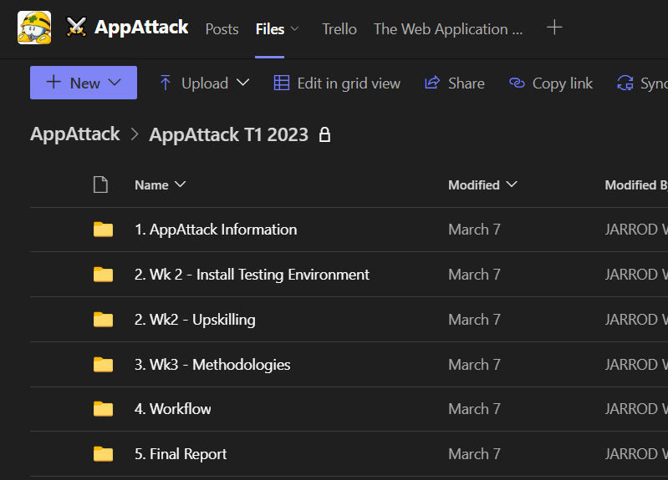
Guide for
AppAttack
Company
Documents
To successfully work on the AppAttack team project, it is important to be aware of several required documents that differ depending on their purpose. These documents can be found in the AppAttack file section, and the directory can be viewed in the image on the left.
Page 04

Slide 5
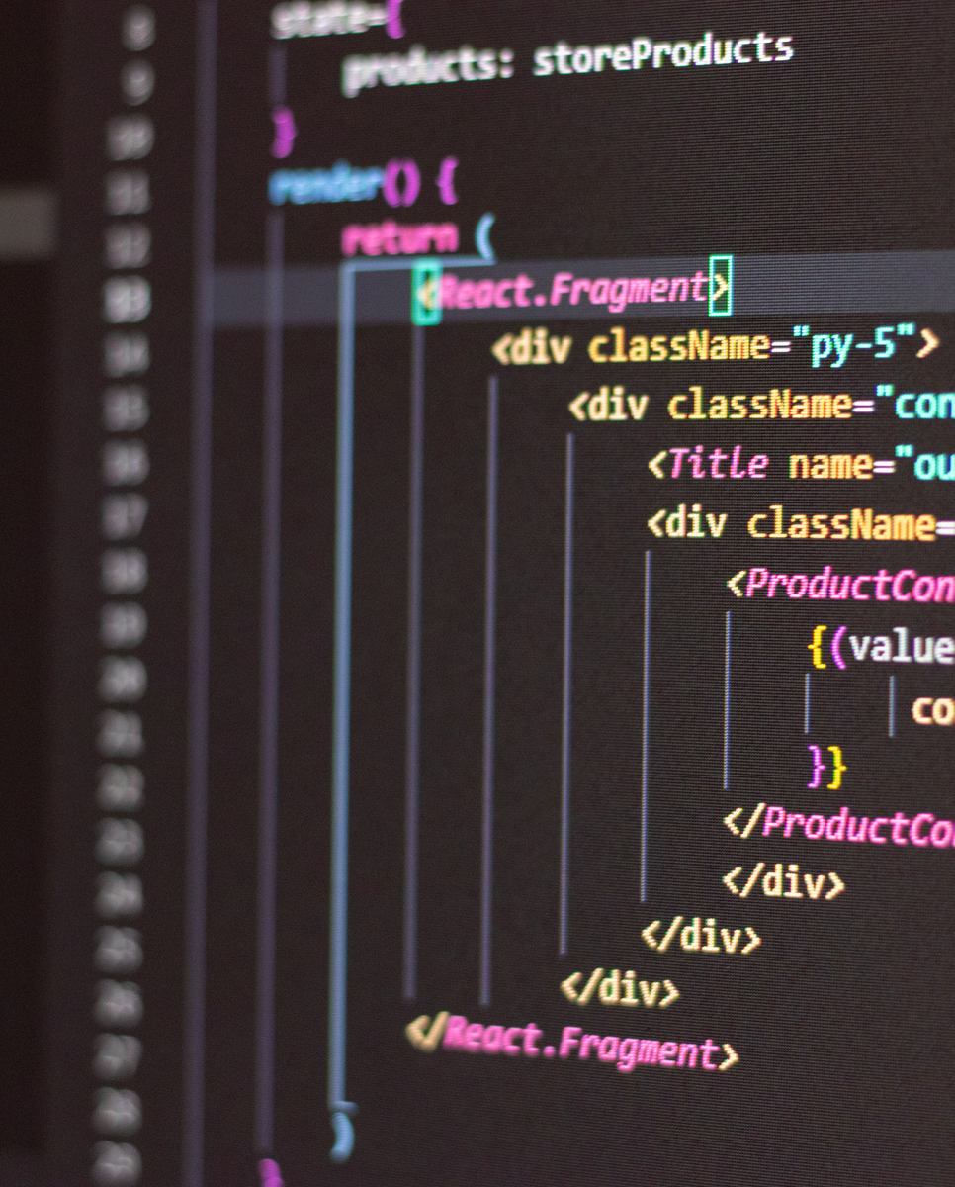

Guide for
AppAttack
Role
SELECTION
The AppAttack team project has two primary roles available: the Secure Code Reviewer (SCR) and the Penetration Tester (PT). Depending on availability, there may also be some defined leadership roles available, but anyone can still take the lead in certain areas to achieve high grades. To delve deeper into the required skillsets for these roles, read on.
SECURE CODE REVIEWER (SCR)
PENETRATION TESTER
(PT)
Page 05

Slide 6
Guide for
AppAttack
SECURE CODE REVIEWER (SCR)
PENETRATION TESTER (PT)
Secure Code Reviewer (SCR) requires a robust comprehension of programming languages, such as Ruby(ruby on rails) and AngularJS.
In-depth knowledge of common software vulnerabilities, detecting and preventing them is crucial for SCR.
SCR must possess excellent analytical and problem-solving skills.
SCR should be able to work independently as well as part of a team.
Strong communication and documentation skills are essential for SCR.
A Penetration Tester (PT) requires knowledge of various operating systems and network architectures, as well as common security threats and attack techniques.
PTs must be proficient in using tools to identify vulnerabilities and exploit them to gain unauthorized access.
Strong problem-solving skills are essential for PTs, and they should be able to work well under pressure.
Excellent communication and documentation abilities are also important for PTs.
more
more
Page 06

Slide 7
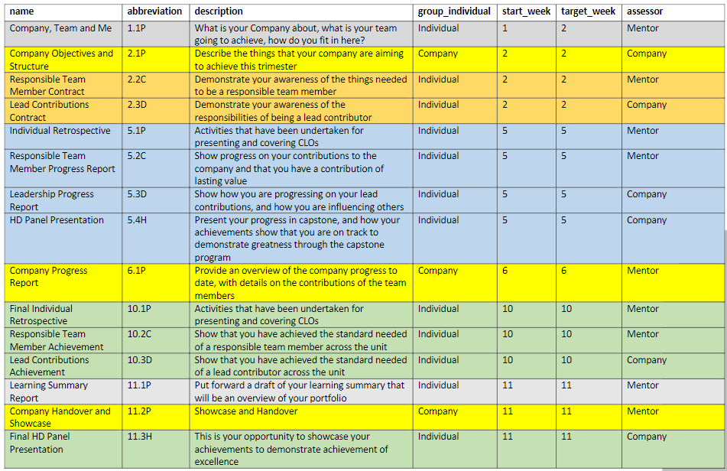
Guide for
AppAttack
Ontrack
Tasks to DO
To ensure optimal productivity within the company, completing tasks on time should be given priority. This requires effective communication with team members and seeking assistance, when necessary, while also gathering relevant evidence as needed. Ultimately, meeting task deadlines is critical to avoiding any negative impacts on your results.
Page 07

Slide 8
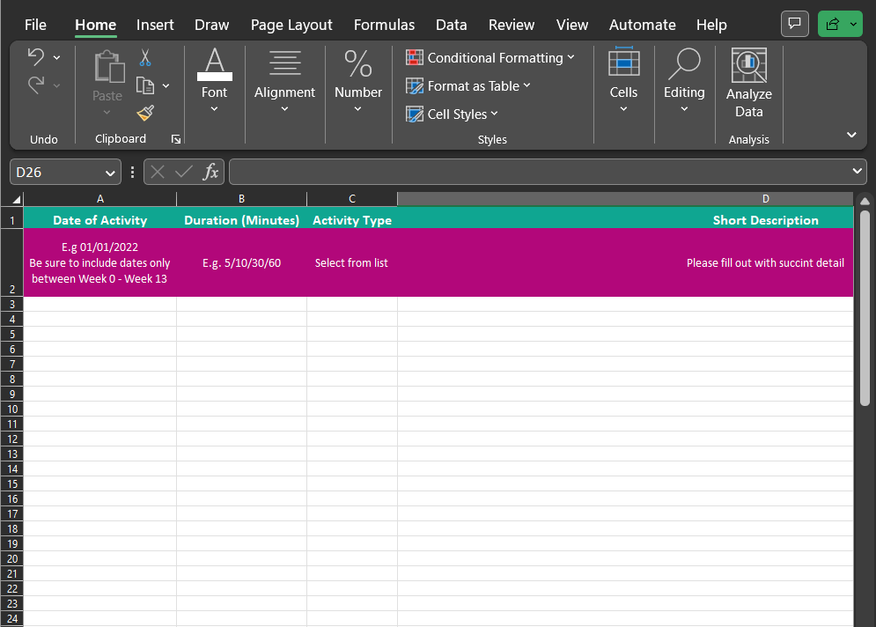
Guide for
AppAttack
Evidence
collection
To gather evidence effectively, team members must keep a detailed record of their activities, including meetings attended, participation in team calls, creating documentation and reports, addressing technical issues, and more. This record should be maintained using the provided log sheet template and capturing relevant evidences, which should include the amount of time spent on each task.
Page 08

Slide 9

Guide for
AppAttack
In order to contribute technically to the team, we follow a workflow process that consists of multiple steps. Below is a brief overview of each step in the process.
"Findings" folder is for documenting pen-test or code review findings; collaborate if possible, and merge if necessary for better detail.
"Verify Findings" folder is for senior/experienced team members to review, validate, and suggest changes to findings in the previous folder.
"Presentation" folder is for final check and polish of verified findings, including spelling, references, and report-ready formatting.
"Final Report" folder is for approved findings that are complete and ready for inclusion in the final report at the end of the trimester.
Contribution
Process
Page 09

Slide 10

Guide for
AppAttack
Who to contact
For help
If a team member needs help, it's crucial to use the designated communication channels within the team to ask for support. Alternatively, you can reach out to a fellow team member or a team leader directly to ask for assistance. It's important to ensure that you communicate your request clearly and provide all necessary information to the person you're asking for help
Page 10

Slide 11

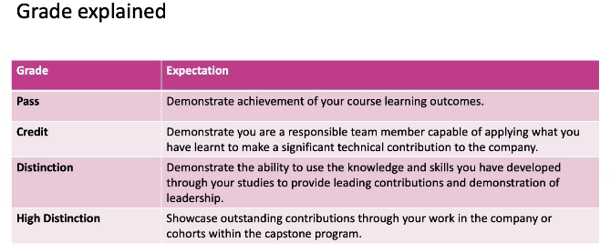
Guide for
AppAttack
Things to
Remember
Throughout this project, we will exclusively use Virtual Machines (VMs), so having compatible devices is vital to make meaningful contributions. Junior members have a 30-hour time cap for upskilling between Week 2 and Week 5. Any upskilling activities exceeding this limit won't count in the time log during the period. Although, there is no time cap besides this period. Lastly, work evaluation will follow the provided rubrics.
Page 11

Slide 12

Guide for
AppAttack
For More
Information
While this guide contains relevant topics, it does not provide a detailed, step-by-step approach for completing specific tasks or processes. Therefore, it is important to review the accompanying Word guide in order to obtain a more comprehensive understanding of any questions or issues that were not fully addressed in this guide.
Additionally, if there are still areas of confusion or uncertainty, don't hesitate to reach out to the leads for further clarification and assistance. As we are here to help and ensure that everyone is equipped with the necessary knowledge and skills to successfully complete the project.
Page 12

Slide 13
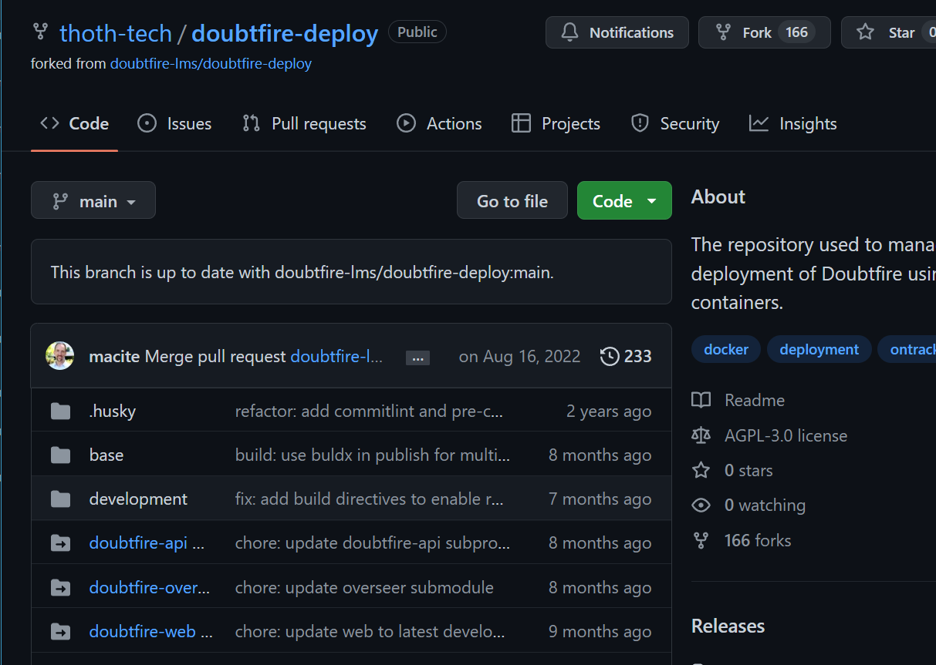
Guide for
AppAttack
Guide for
VM Deployment
By following the instructions given in the "contributing.md" file, anyone can easily run the system locally without facing any issues. This document is an essential resource for members looking to contribute to the Ontrack project and helps to ensure that everyone has access to the necessary tools to work on the project effectively.
Link: https://github.com/thoth-tech/doubtfire-deploy
Page 13

